Slide 1
A
Project
On
“WEB BASED UNIVERSITY MANAGEMENT SYSTEM”
Submitted By
Yashashvi Thakur
PRN – 220960820071
PG-DAC
SEPTEMBER 2022

Slide 2
Introduction
Why web based management system ?
Globalization of the university to attract students and faculties from all around the world.
Global platform for the audiences (i.e. viewers), faculties as well as for students to access the information from anywhere through the internet.
Easy data handling as data can be accessed as well as managed remotely through PC with proper internet connectivity without storing huge amount of hard copies.
Being on web, it provides a global platform for the audiences as well as students to stay updated about the organizational activities.

Slide 3
Objectives
The web based university management system will be a digital solution for helping in automation of the tasks that will provide access and management of information's in a university such as Student details, Faculty/Staff details, Fee Payments, Form submissions, Advertisements etc.
The main objective of this web based management system is to avoid entries of the hard copies and to save the burden of storing the data and easy management of resources.
To provide databases which stores, manage as well as retrieve the information provided by the different modules of the university management system.
To provides capabilities for registering students in courses, Admitting students, Submitting student documents, showing student attendance etc.

Slide 4
Project Category
It is a web based application.
Unlike traditional applications, it is accessible anytime, anywhere, via a PC with an Internet connection in it.
It need lower requirements on the end user system and has simplified architecture with user friendly UI Design.

Slide 5
Tools & Platform
For this management system, HTML, CSS, JavaScript, Spring Boot is used for the website layout.
Java is used as the programming language for the system.
To save, retrieve and manage the data, MySQL database is used.
For connection of database, JDBC(Java Database Connectivity) is used.
As an development tool for the website, eclipseIDE 2022-09 is used.
To access the website, we can use any type of web browser such as Google Chrome, Microsoft Edge, Mozilla Firefox etc.

Slide 6
Hardware &
Software Requirements
It needs most recent version of Google Chrome, Microsoft Edge, Mozilla Firefox , or Safari.
Minimum Hardware Requirements :
-CPU : Single Core 2.4 GHZ
-RAM : 512 MB
-Graphics Card : Intel or Nvidia
-Hard Drive : 2 Gigabytes
-Network : Broadband Recommended or good speed connection.
-Processor : Pentium
-Operating System : Window(XP, Vista, 7,8,9,10,11),Mac OS, Linux, Unix.

Slide 7
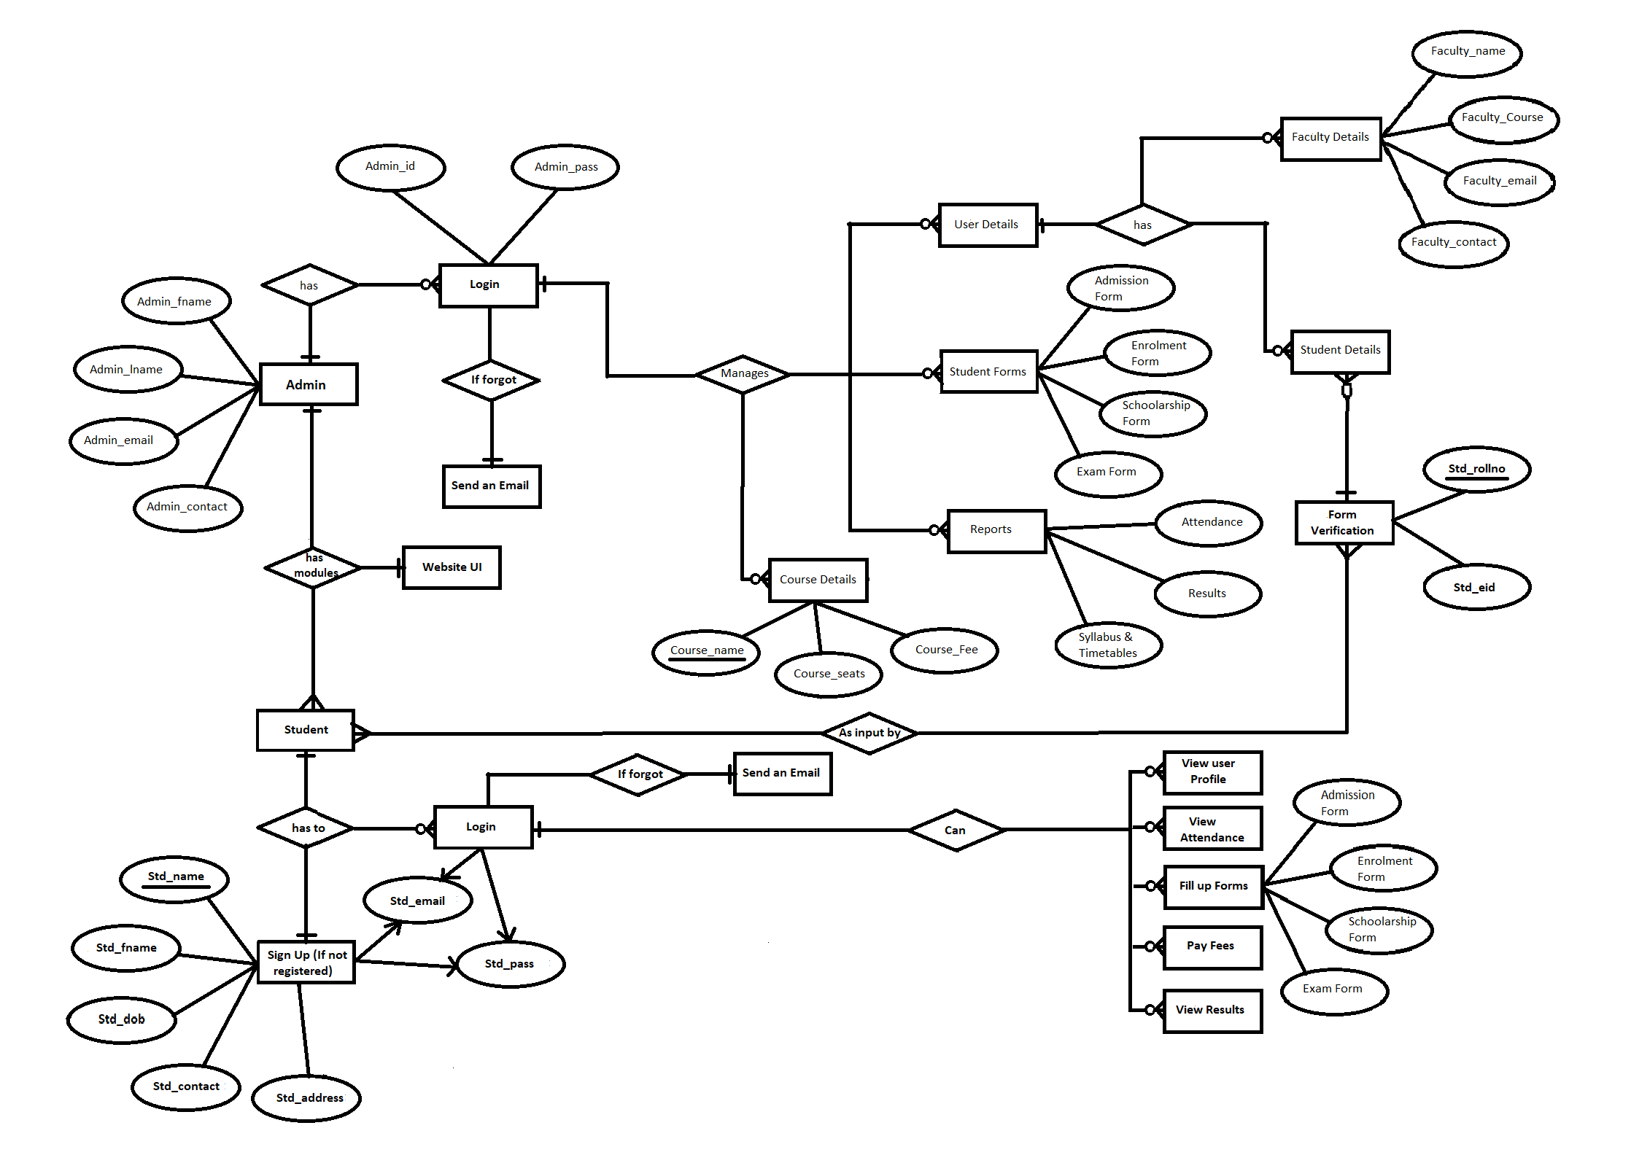
E-R Diagram

Slide 8
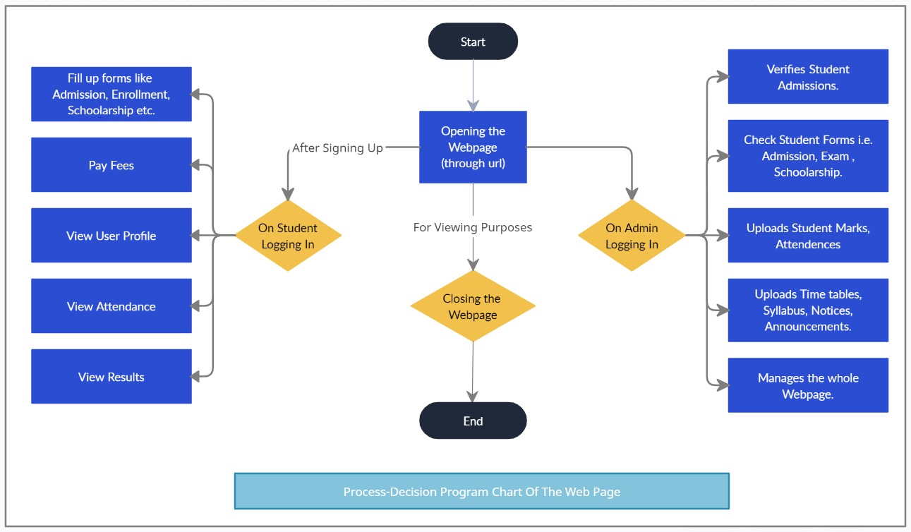
PDPC Diagram

Slide 9
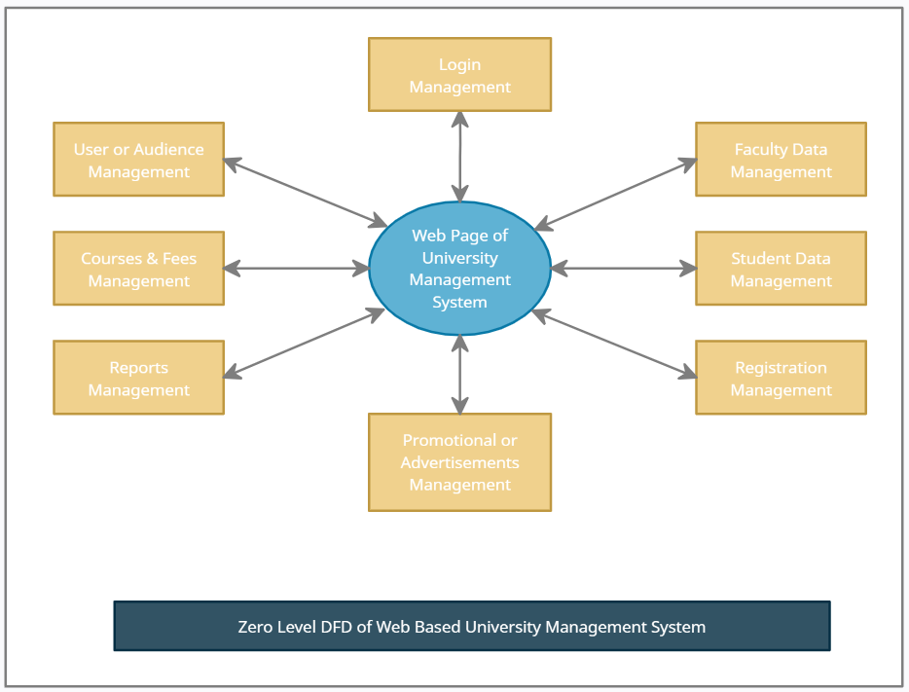
Data Flow Diagram

Slide 10
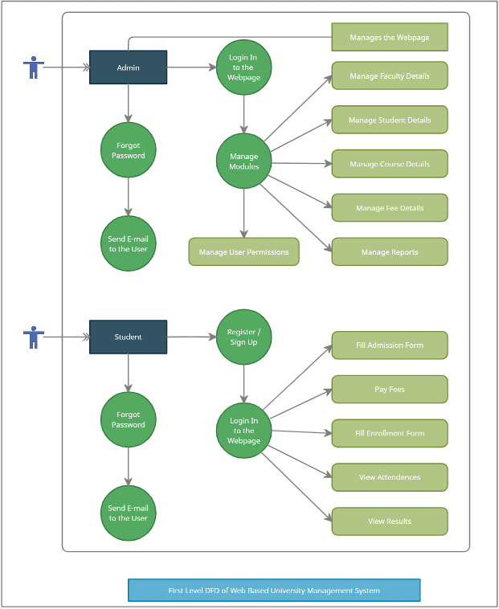

Slide 11
Modules
It is based on two modules :
Admin Module : Which have access to read, write and execute the database. Admin Module will act as the controller or manager of the entire website contents.
Student Module : Which can write only allocated forms and have read access of the entire website.

Slide 12
UI Design
This web based university management system which is a digital solution for helping in automation of the tasks that will provide access and management of information of different modules in a university like Students, Teachers / Staff, Finance, Examination, HR etc.
This project is based on the database, which stores, manage as well as retrieve the information provided by the different modules of the university management system. The advantage of this web based management system is to avoid entries of the hard copies and to save the burden of stories the data in hard copies for an easy management of resources.

Slide 13
DB Design
This web based university management system which is a digital solution for helping in automation of the tasks that will provide access and management of information of different modules in a university like Students, Teachers / Staff, Finance, Examination, HR etc.
This project is based on the database, which stores, manage as well as retrieve the information provided by the different modules of the university management system. The advantage of this web based management system is to avoid entries of the hard copies and to save the burden of stories the data in hard copies for an easy management of resources.

Slide 14
Future Scope
This web based university management system project can be implemented as such that colleges under the university can also me accessed and managed.
Other Possible Modules :
Attendance Management
Hostel
Library
Examination Module

Slide 15
Bibliography
Websites :
www.cdac.in
www.github.com
www.google.com

